Slide 1
Promise Pathways to STEM a P-20 Council Initiative
A Partnership Between
CSU Channel Islands,
Oxnard College,
Oxnard Unified High School District

Slide 2
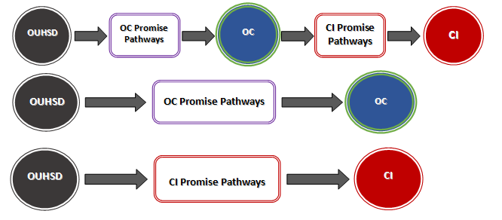
Promise Pathways to STEM

Slide 3
Promise Pathways to STEM
Focus Pathways
Middle School
Lemonwood
(K-8)
E.O. Green
(6-8)
Blackstock
(6-8)
High School
Channel Islands HS
-Marine Science
-Engineering
Hueneme HS
-Engineering & Design

Slide 4
CI Promise Pathways Goals
To promote higher education as an attainable goal
To increase knowledge of STEM college and career pathways by OUHSD students
To increase readiness of OUHSD students for studying STEM in college
To increase the percentage of OUHSD students successfully transferring to Oxnard College, CI, or another four-year college or university

Slide 5
CI Promise Pathways Components
OUHSD and OSD Students:
  Guaranteed admission for any OUHSD senior from HHS and CIHS who meets minimum admission requirements and is pursuing STEM at CI minimum
  STEM Pathways/ College-Knowledge Presentations to Middle and High School Students (PROMESAS)
  Coaching by CI Peer Mentors/ Coaches (PROMESAS)
  Articulation Summit (PROMESAS)
Oxnard College Students:
  Articulation Summit (PROMESAS)
  STEM Transfer Academy

Slide 6
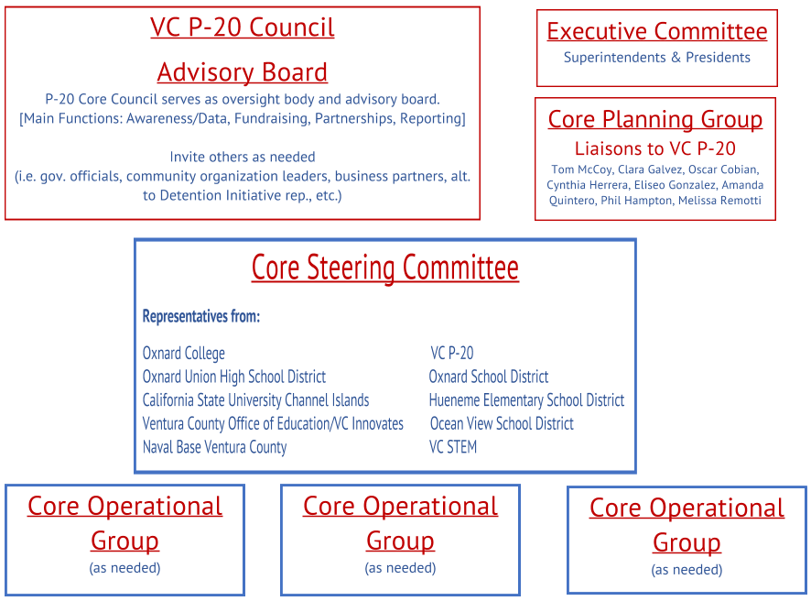
PROMISE PROGRAM Structure
CI Steering Committee Members
- Scott Frisch / Academic Programs
Hung Dang / Admissions
Faculty Rep(s) (1-2)

Slide 7
PROMISE PROGRAM Timeline
Ongoing – Bi-monthly to Quarterly meetings of Core Steering Committee
February – 8th Grade Receives Promise Program Initial Information
March – Establish Core Operational Groups & meeting schedule
March – Parent Information Sessions & Mailings
April – Promise Program LAUNCH!: MOU Signing & Student Pledge Day

