Slide 1

CI’s Student Basic Needs &
Emergency Intervention Program
Presented to the Academic Senate
March 28, 2017

Slide 2
The California State University (CSU) Involvement & Response
Office of the Chancellor Study on CSU Food and Housing Security
  Key Findings
    Staff, faculty, and administrators estimated displaced students at 8.7% and food insecure students at 21%; however, preliminary student survey results show 12% and 24%.
    Students who experienced food and/or housing instability reported high levels of stress and the need for single points of contact.
    Approximately 1 out of 3 college students currently experiences food insecurity

Slide 3

The CSU Channel Islands (CI)
Involvement & Response
Charge from President Beck
  Define a Purpose Statement
  Develop a Task Force
  Identify Goals
  Establish Deadlines

Slide 4
The CSU Channel Islands (CI)
Involvement & Response (cont.)
Student Basic Needs & Emergency Intervention Taskforce
    Purpose Statement: The CI Student Basic Needs & Emergency Intervention Task Force is responsible for identifying interventions and strategies for Emergency Funds, Food Security, and Housing Security.

Slide 5
Task Force & Sub-committees
  Student Basic Needs & Emergency Intervention Taskforce
    Chair: Toni DeBoni, Associate Vice President for Student Affairs & Dean of Students
    Emergency Funds
      Chair: Dottie Ayer, Special Assistant to the Vice President for Student Affairs & Strategic Operations Administrator
    Food Security
      Chair: Ed Lebioda, Associate Vice President for Student Affairs – Wellness & Athletics
    Housing Security
      Chair: Cindy Derrico, Associate Vice President for Student Affairs – Housing & Residential Education and Associated Students Inc.

Slide 6

Sub-committee: Emergency Funds
Short-Term Goals
    Establish Emergency Funds Grant
      Identify Dollars
      Create an application process
      Create an application review & disbursement process
      Accessibility to students

Slide 7

Sub-committee: Emergency Funds (cont.)
Long-Term Goals
    Develop a possible Loan Program (with higher allocations and lifetime maximums)

Slide 8

Sub-Committee: Food Security
Short-Term Goals
  Create CI Food Pantry
    Obtain Donations
    Volunteers
  Current Location: Ojai Hall 1978
  Summer 2017: Arroyo Hall First Floor

Slide 9

Sub-Committee: Food Security (cont.)
Long-Term Goals
  Hot Meals
  Identify Outside Resources
  Registration/Administration

Slide 10

Sub-Committee: Housing Security
Short-Term Goals
  Grants/Resources for short-term housing needs
  Temporary Stay Plans – On Campus
  Priority Housing Registration for certain protected classifications

Slide 11

Sub-Committee: Housing Security (cont.)
Long-Term Goals
  Temporary Stay Plans – Off Campus (volunteer housing, hotel vouchers, etc.)

Slide 12

Sub-Committee Joint Collaborations
Marketing
    Website Development
    Advertising
Monetary Donations
    Multiple Foundation Accounts
    Advertising/Solicitations
    On-line Donation Options
    Payroll Deduction Option for CI Faculty and Staff
Staffing
    Case Manager Position
    Volunteers
Assessment
    Capstone Projects for CI Students

Slide 13

How you can help?
Educate others!
Make a Monetary Gift!
  http://www.csuci.edu/giving/
Donate Food and Personal Hygiene Items!
Let us know about partnership opportunities!

Slide 14

Resources
CSU Basic Needs Initiative website
www.calstate.edu/BasicNeeds

Slide 15
Questions?

Slide 16
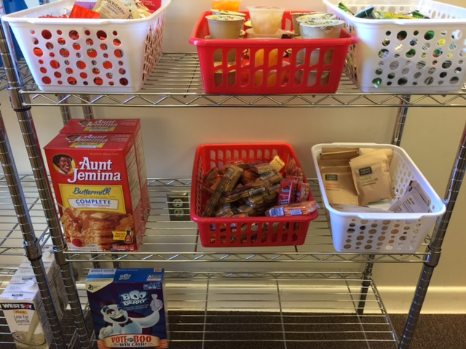
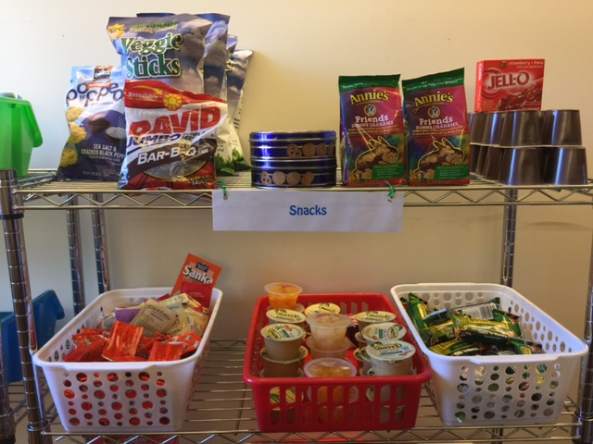
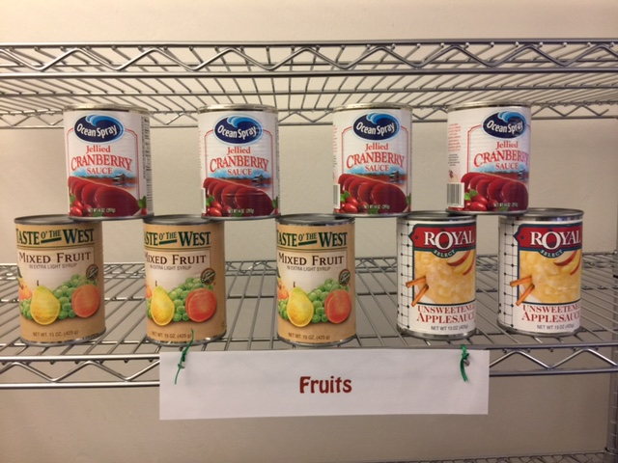
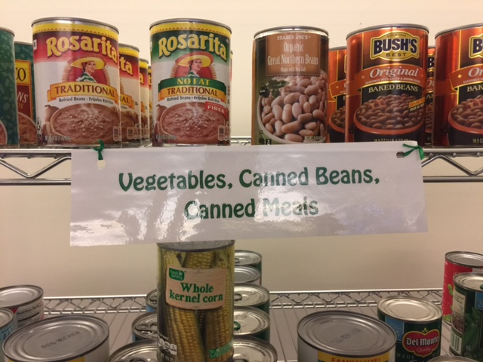

Slide 17
