Slide 1

California State University Channel Islands and Ventura County Transportation Commission Intercity Proposed Bus Schedule Change
Transportation and Parking Services

Slide 2
Overview
The proposed schedule change concepts were prepared following consultation between California State University Channel Islands (CSUCI) and the Ventura County Transportation Commission (VCTC) with the goal of ascertaining potential cost savings and service optimizations to the campus community.
The following analysis is of recent route performance for the summer/winter break periods and weekends. VCTC staff have identified the potential for significant cost savings to the University while maintaining similar service levels with minimal reductions.

Slide 3
Existing Bus Service
Currently, the set of CSUCI routes operate on a frequency of 30 minutes for the Camarillo-CSUCI route, and every hour for the Oxnard-CSUCI route. The frequency is the same during the school year, on weekends and during breaks (winter & summer). Although, on weekend and during the breaks, the last trips of the evening are generally at 5:00pm and 5:30pm vs. 10:15pm and 10:35pm on weekdays during the school year.

Slide 4
Average Ridership Per Trip
CSUCI’s ridership is at its highest during the academic year on weekdays. Utilization decreases significantly on weekends and during the break periods.
The following table represents the average ridership per trip:
Weekdays | Camarillo Loop | Oxnard Loop
School Year | 15 | 13
Winter Break | 3 | 2
Summer Break | 4 | 6
Saturdays | Camarillo Loop | Oxnard Loop
School Year | 3 | 3
Winter Break | 1 | 1
Summer Break | 2 | 1
Results from Summer 2015/2016
Fall/Spring 2016/2017 (current data)

Slide 5
Proposed Schedule Modifications
VCTC currently operates a route between Oxnard C-Street, and Camarillo Metrolink called the “Oxnard-Camarillo Connector”. This route, funded by a state grant, is planned for operation for another two years. The new proposed route would combine this existing route with the route pattern operated by the Camarillo-CSUCI route.
The proposed level of service would:
  Increase to seven days per week, Monday – Sunday. Currently CSUCI does not run on Sundays.
  Provide Student Housing with bus service 7 days a week.
  Operate one additional trip into the evening hours.
  Reduce weekday service during breaks to 1 hour frequency, and eliminate the direct connection to Oxnard C-Street.
  Allow passengers to take the Oxnard-Camarillo Connector.

Slide 6
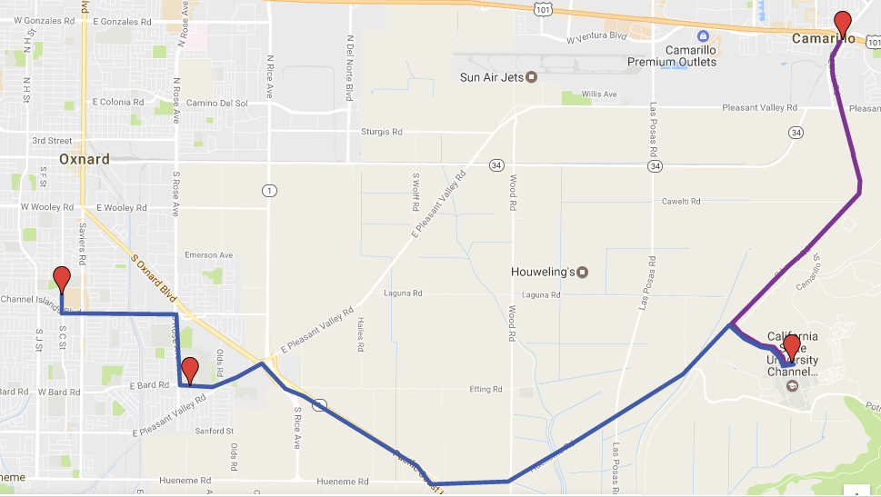
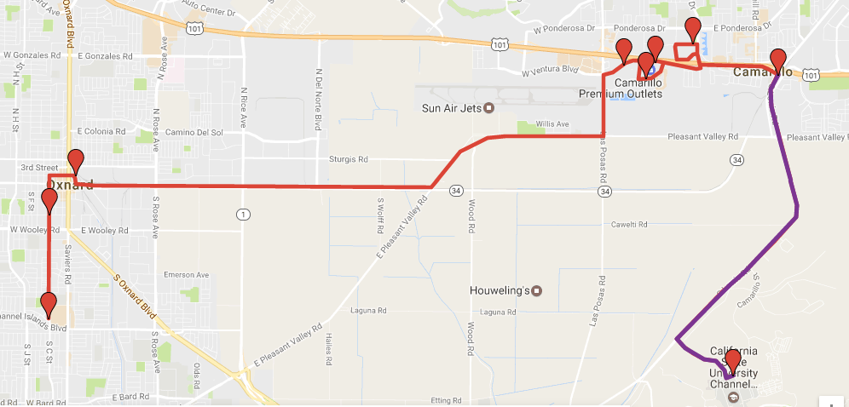
Current Route
Proposed New Route

Slide 7
Financial Impact
Current service level costs are reflected in the table assuming no change to the schedule for FY16/17 or FY17/18 (projected).
The estimated costs for the same period are represented here as well. This assumes the reduction of service begins May 22, 2017 and continues throughout the school year on weekends and during the winter break and again in the summer.
The total projected savings to CSUCI would be approximately $85,700, but a one time savings of $105,700.
BUDGET/ESTIMATED COST PER YEAR
2016/2017 | $ 527,000
2017/2018 | $ 540,700
WITH RECOMMENDED CHANGE
2016/2017 | $ 507,000
2017/2018 | $ 455,000

Slide 8
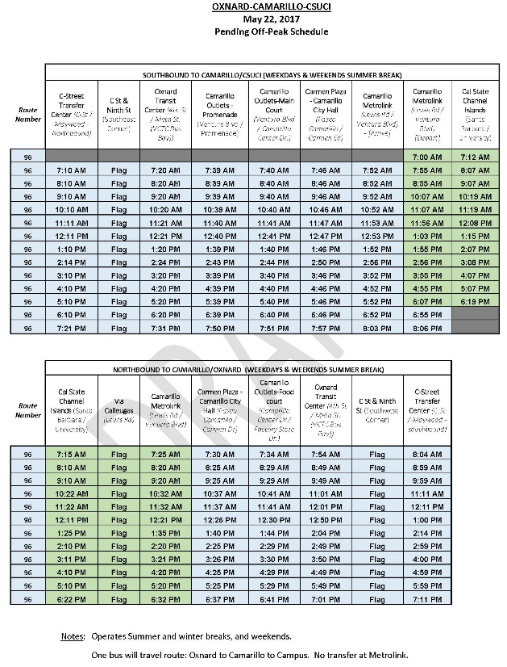
Proposed Bus Schedule
VCTC staff is still in the process of making adjustments to the bus schedule in order to allow for arrival time to be a quarter before the hour and for departure time to be a quarter after the hour.

Slide 9
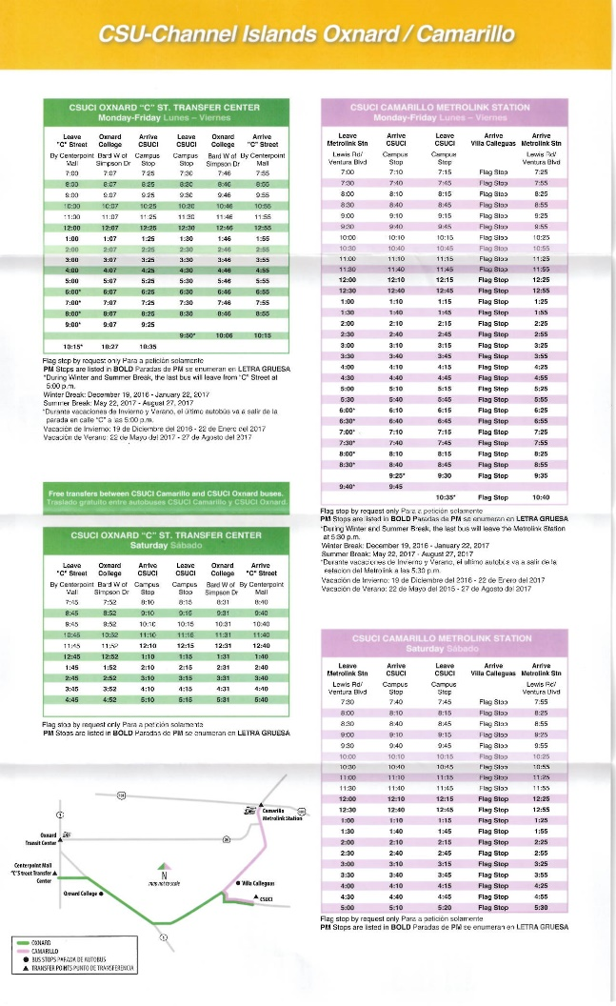
Current Bus Schedule

Slide 10
We would love to hear your feedback:
Call or email us at any time.
Transportation & Parking Services
Placer Hall
(805) 437-8430 (office)
parking@csuci.edu

