Slide 1
Budget Update
April 29, 2014

Slide 2
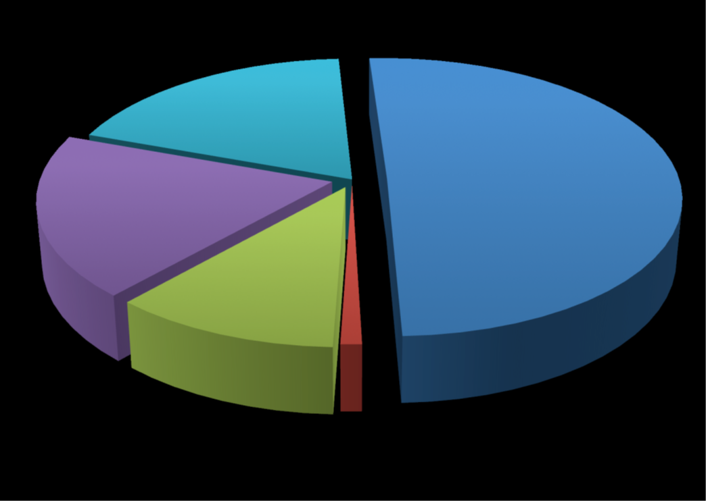
Functional Classification Expense Comparison
FY 2013
O&M 19%
Instruction/Academic Support
50%
Institutional Support
19%
Student Services
11%
Research 1%
Source: Ysabel Trinidad, VP for Fiscal Services, 2014

Slide 3
New Tenure-Track Faculty 2014-15
Prepared by Faculty Affairs Office

Slide 4
New Tenure-Track Faculty
Rank and Program
Faculty Rank - Program
Ms. Colleen Harris-Keith Assistant Librarian
Dr. Geoffrey Dilly Assistant Professor - Biology: Animal Physiology
Dr. Ahmed Awad Assistant Professor - Chemistry
Dr. Jennie Luna Assistant Professor - Chicana/o Studies
Dr. Brian Thoms Assistant Professor - Computer Science
Dr. Bryan Tomlin Assistant Professor - Economics
Dr. Michelle Dean-Lorenzini Assistant Professor - Special Education
Dr. Nien-Tsu Chen Assistant Professor - Health Communication
Dr. Susan Andrzejewski Assistant Professor - Marketing
Dr. Ekin Pehlivan Yalcin Assistant Professor - Marketing
Dr. Selenne Banuelos Assistant Professor - Mathematics
Ms. Cynthia Flores Assistant Professor - Mathematics
Ms. Colleen Nevins Assistant Professor - Nursing: Medical Surgical
Dr. Matthew Campbell Assistant Professor - Psychology
Dr. Margarita Lopez Assistant Professor - Spanish
Dr. Carol Mack Associate Professor - Gerontology/Health Sciences
Dr. Michael Soltys Professor - Computer Science

Slide 6
