Slide 1
Solar Photovoltaic Project
at CSU Channel Islands
Briefing to Academic Senate on April 17th 2018

Slide 2
History of project
Solar PV on campus considered for many years.
Cogeneration facility provided low cost power - financials did not work out.
30 year agreement with CI Power just ended.
MEA from CO.
Power Purchase Agreement (PPA) - no upfront capital and reduced risk.
CSU Sustainability goals.

Slide 3
Current situation
Issued RFP for 3MW of AC Power.
Identified developable areas. Includes parking lots for canopy solar and unused land for ground-mounted solar. No roofs. Map of areas on next slide.
Campus is growing in overall electric load. 3MW is planning ahead.
Per kwh rate will result in immediate savings and long-term predictable costs.
Proposals due May 2nd. Still answering RFI’s and clarifying scope.

Slide 4
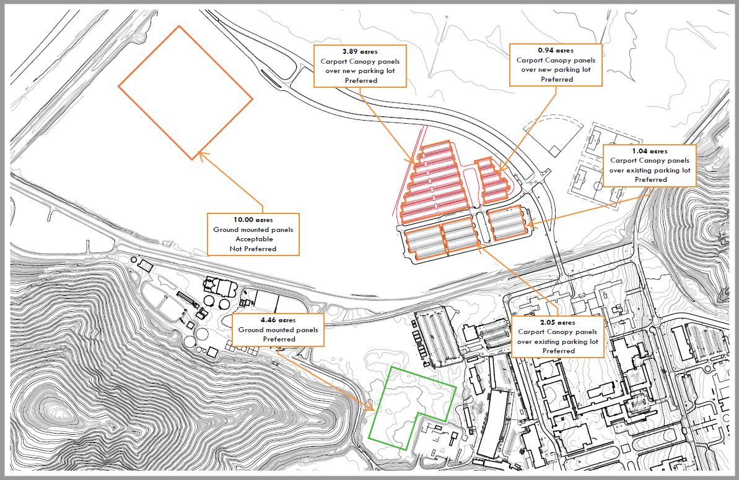
Map of developable area

Slide 5
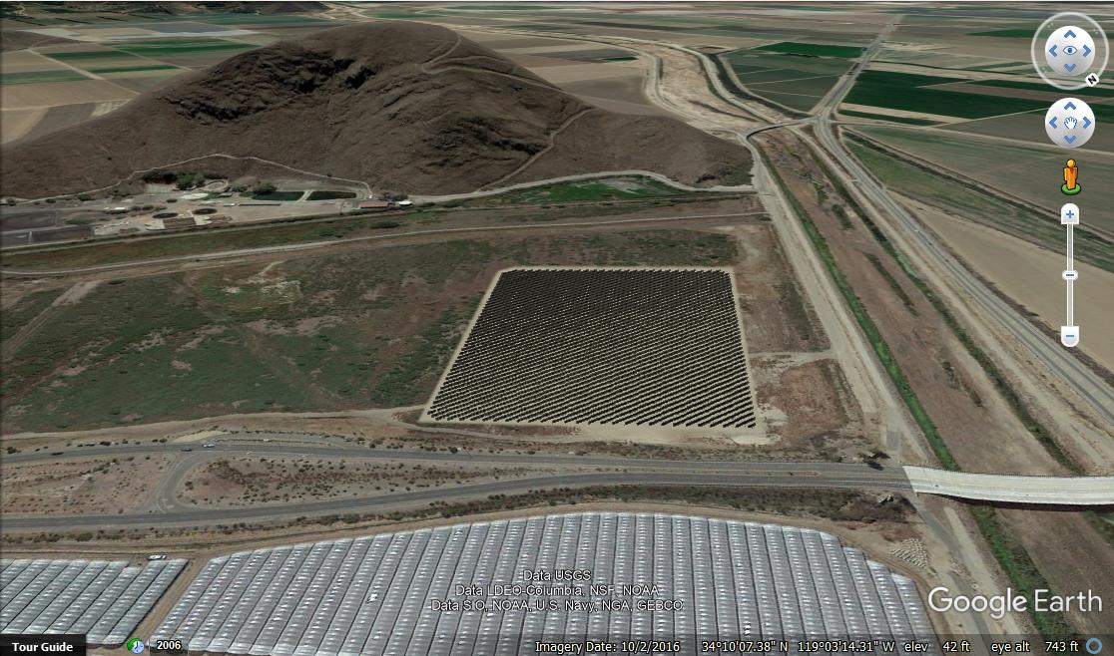
Digital mock-up of 10 acres in flood plain

