Slide 1
2025 Initiative:
CSU and CI Metrics & Benchmarks
Institutional Research, Planning & Effectiveness
Judy King Kristin Jordan Bob Ngo Michael Bourgeois
Data Analyst Consultant Senior Analyst Executive Director

Slide 2

2025 Initiative Student Success Metrics

Slide 3
Graduation Initiative 2025 Goals
Notes:
Definitions have changed.

Slide 4

Readiness

Slide 5
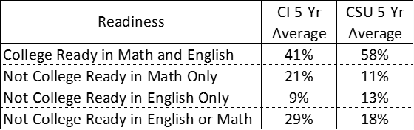
Average CI & CSU College Readiness

Slide 6
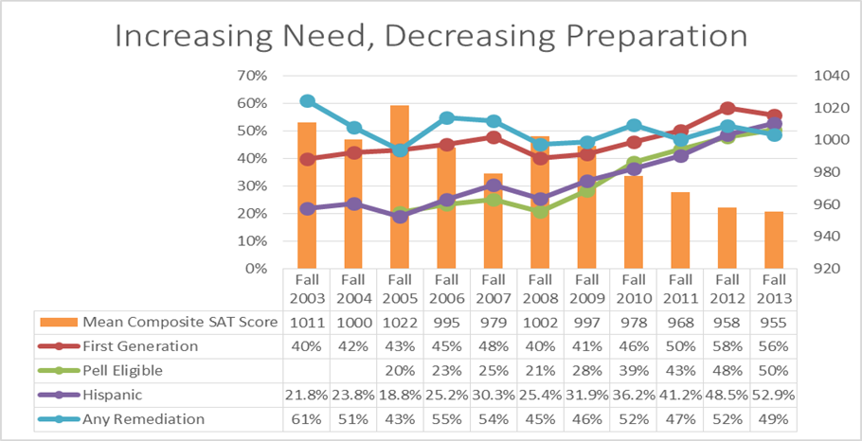
Channel Islands Student Preparation &
Need Trends upon Entry

Slide 7


Slide 8
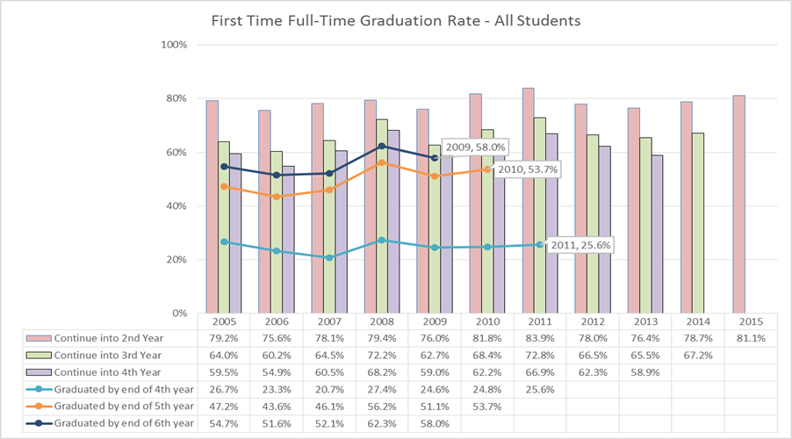
First Time Full Time Graduation Rates

Slide 9
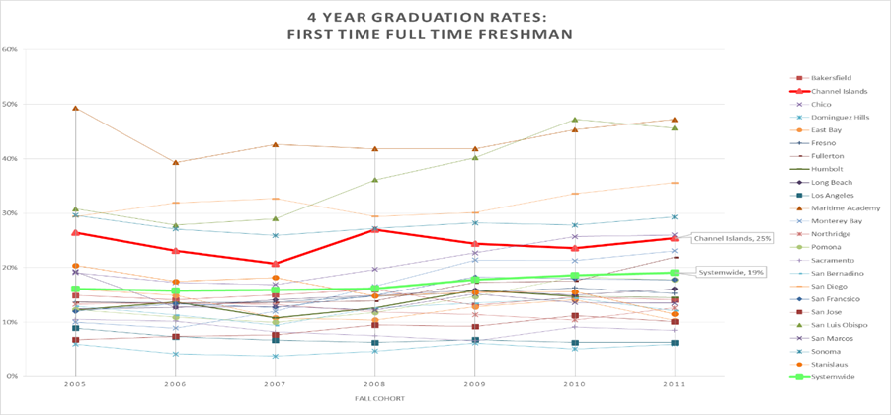
Four Year FTFT Freshmen Graduation Rates Comparison across all Campuses & Systemwide

Slide 10
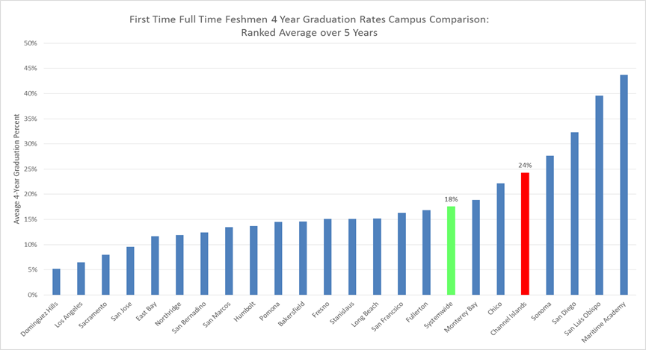
Four Year Ranked Average FTFT Freshmen Graduation Rates across all Campuses &Systemwide

Slide 11
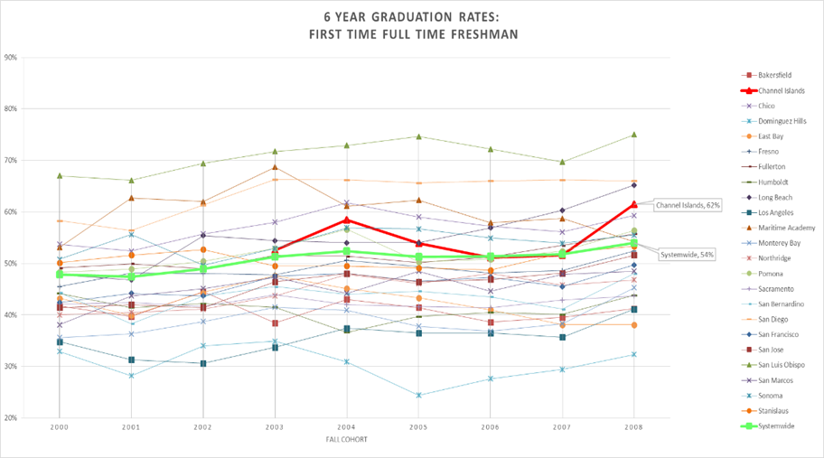
Six Year FTFT Freshmen Graduation Rates Comparison across all Campuses & Systemwide

Slide 12
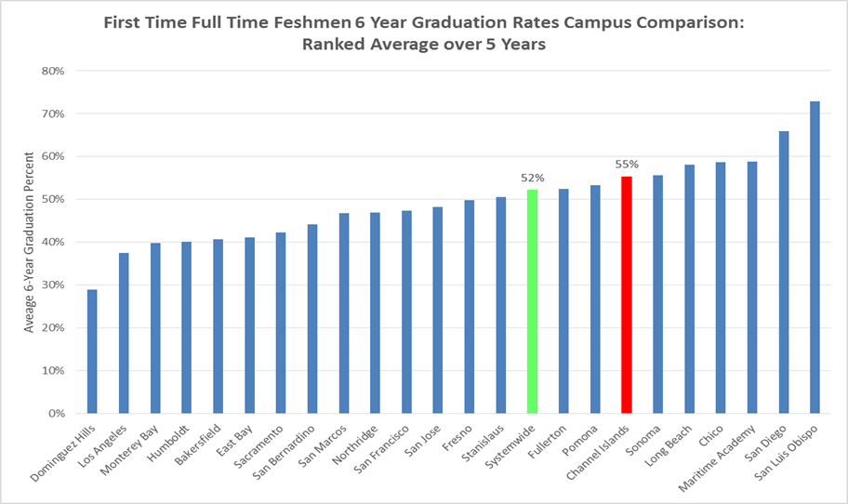
Six Year Ranked Average FTFT Freshmen Graduation Rates across all Campuses & Systemwide

Slide 13
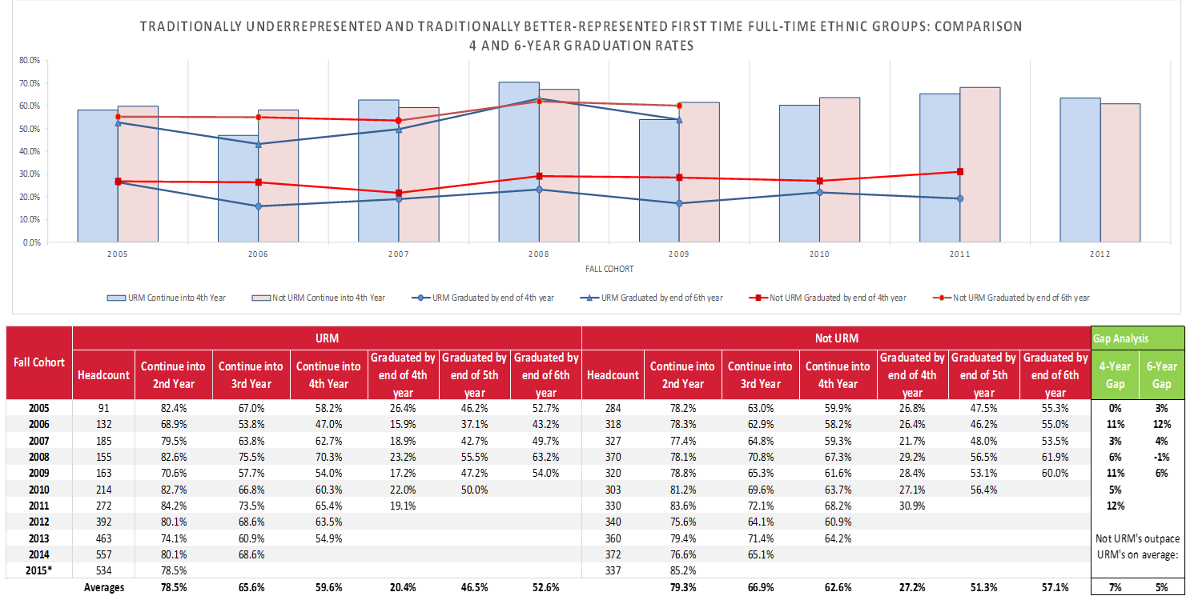
Channel Islands FTFT Freshman 4 & 6 Year URM Graduation Gap
Notes:
traditionally underrepresented ethnic groups entering CI as first time full-time freshmen continue into the 4th year and graduate in 4 and 6 years at slightly lower rates than not-URM ethnic groups. Our URM 4-year graduation gap averages 7%. The 6-year URM graduation gap averages 5%, closing with the 2008 cohort but increased the next year.

Slide 14
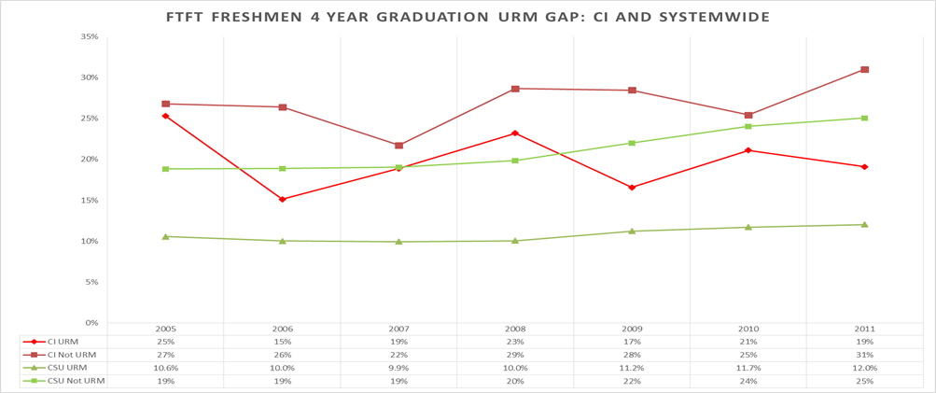
FTFT Freshmen 4 Year URM Graduation Rates Gap Comparison CI & CSU
Notes:
CI (red) and the CSU (green) across 4 year URM and not-URM graduation rates. The URM gap is increasing over time for both CI and the CSU, but CI has more variability. CI has higher rates than the CSU across both measures (URM and not-URM 4 year rates), and smaller gaps, which is better displayed below.

Slide 15
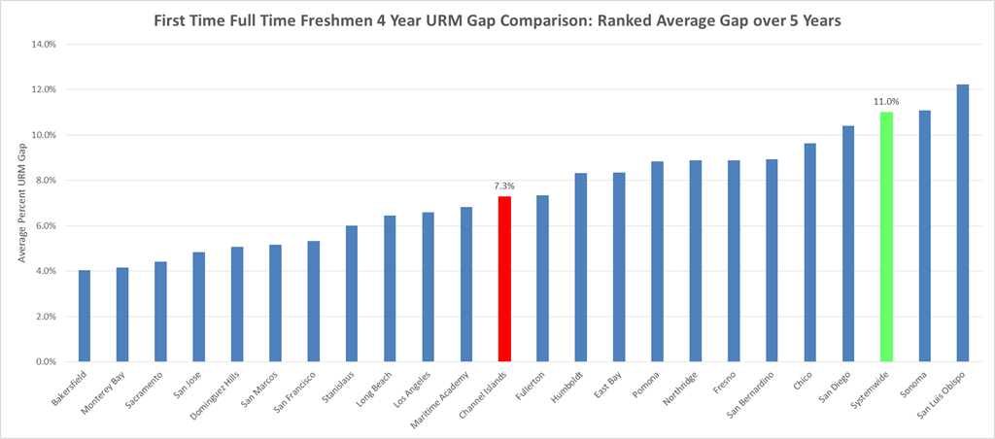
Average URM 4 Year Graduation Rate Gap in Comparison
Notes:
reports the 4 year graduation rate gap between URM and not-URM averaged across the most recent five fall cohorts for each campus. Campuses are arranged from lowest average gap to highest. Channel Islands falls about in the middle of the distribution, 4 percentage points lower than the systemwide average.

Slide 16
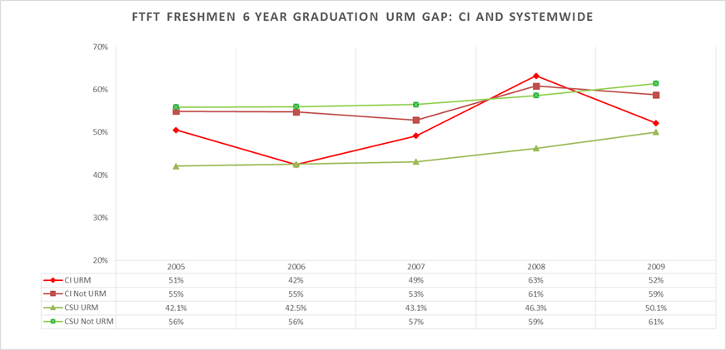
FTFT Freshmen 6 Year URM Graduation Rates Gap Comparison CI & CSU
Notes:
compares CI (red) and the CSU (green) across 6 year URM and not-URM graduation rates. The URM gap is steady over time for the CSU, but closes for CI beginning in 2007. CI has higher rates than the CSU across both measures (URM and not-URM 4 year rates), and smaller gaps, which is better displayed below.

Slide 17
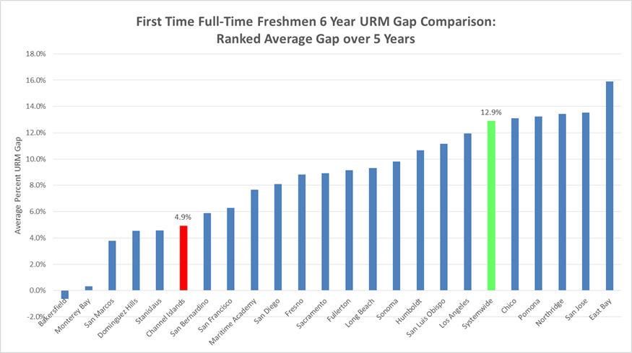
Average URM 6 Year Graduation Rate Gap in Comparison
Notes:
the 6 year graduation rate gap between URM and not-URM averaged across the most recent five fall cohorts for each campus. Campuses are arranged from lowest average gap to highest. Channel Islands falls has the sixth lowest gap (4.9%), 8 percentage points lower than the systemwide average.

Slide 18
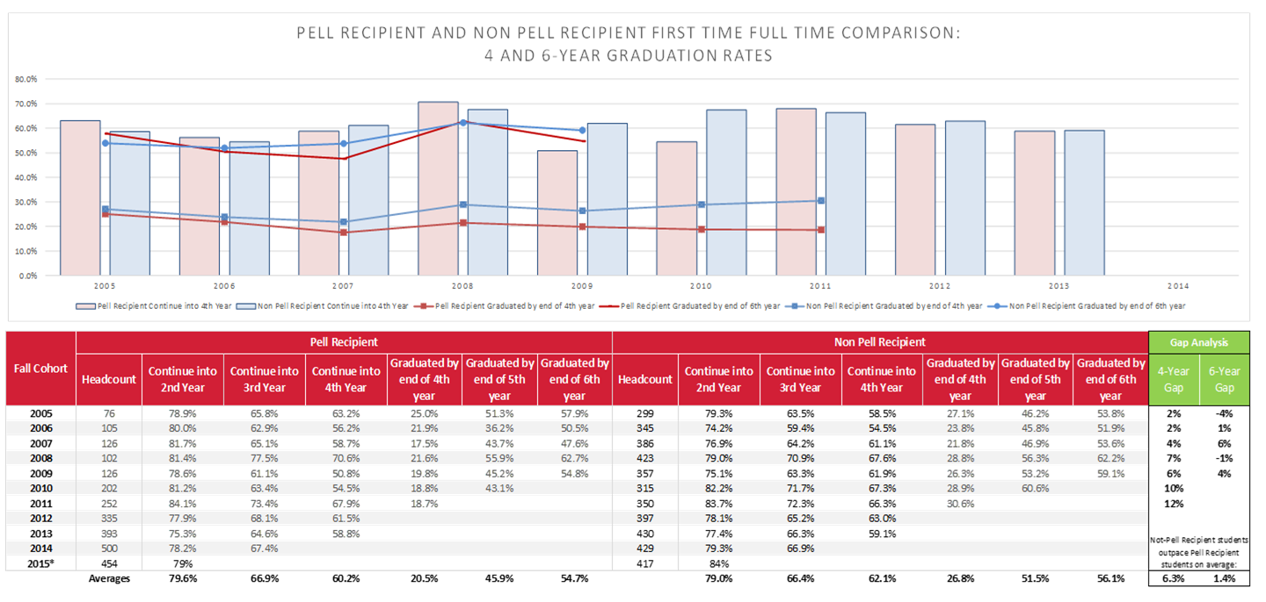
Channel Islands 4 and 6 Year FTF Pell *Recipient* Graduation Gap
Notes:
CI Pell recipient students (red) graduate as slightly lower 4 and six year rates than do not-Pell eligible students. The four year gap appears to be increasing, but the six year gap has closed to within 3% points.

Slide 19
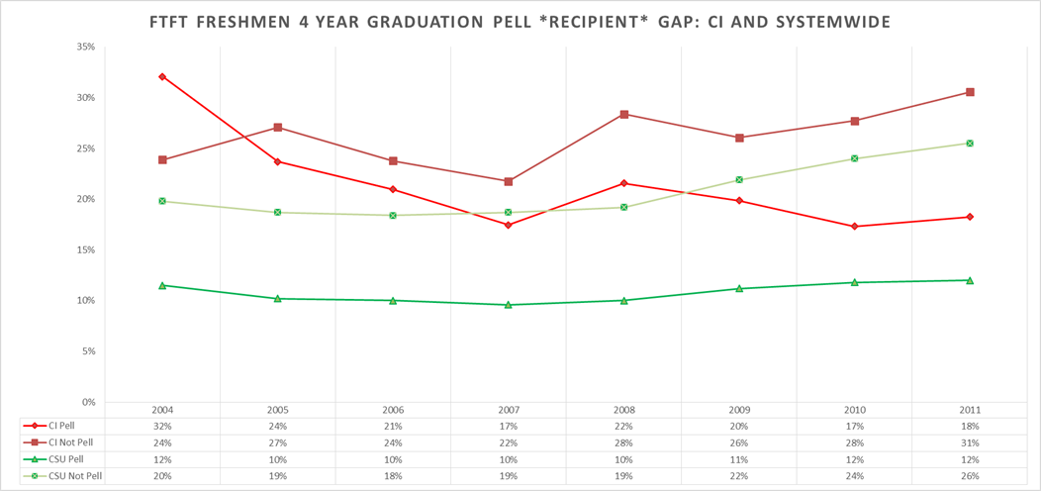
FTFT Freshmen 4 Year Pell Recipient Graduation Rates Gap CI & CSU

Slide 20
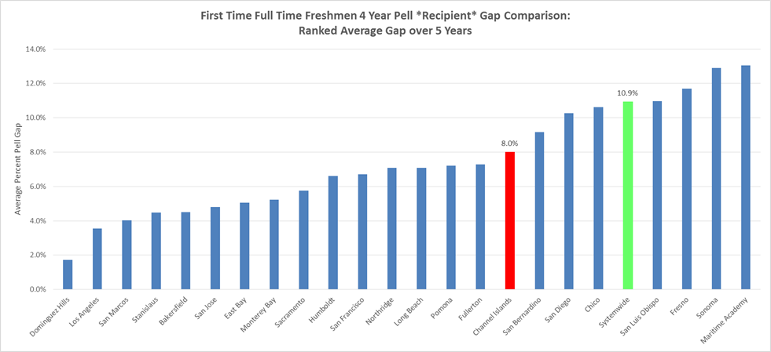
Average Pell 4 Year Graduation Rate Gap in Comparison

Slide 21
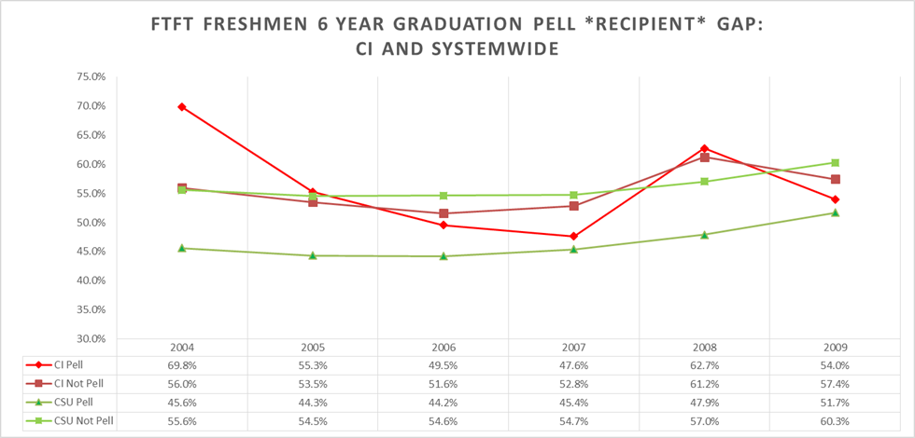
FTFT Freshmen 6
Year Pell Recipient Graduation Rates Gap CI & CSU

Slide 22
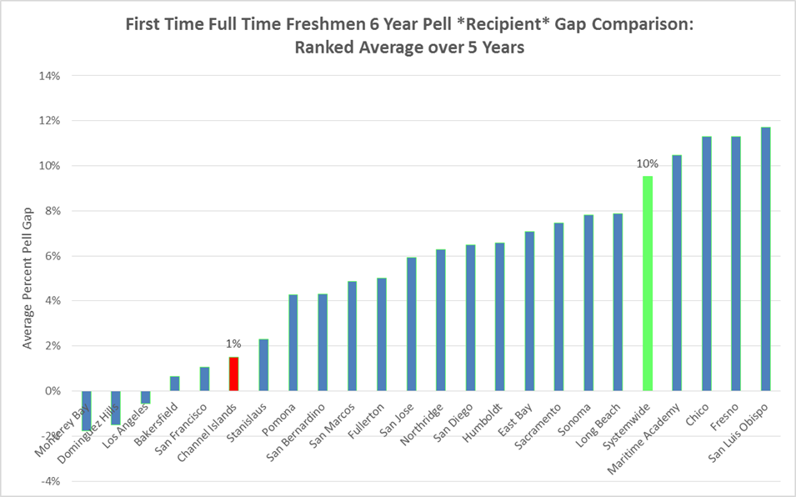
Average Pell 6 Year Graduation Rate Gap in Comparison

Slide 23
FTFT Freshmen First Generation

Slide 24


Slide 25
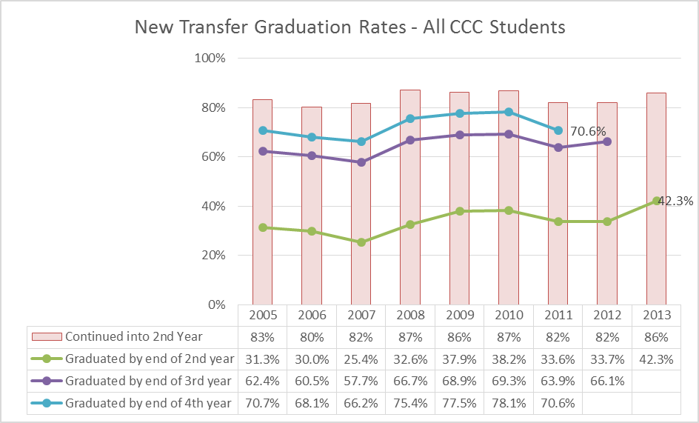
Transfer Graduation Rates

Slide 26
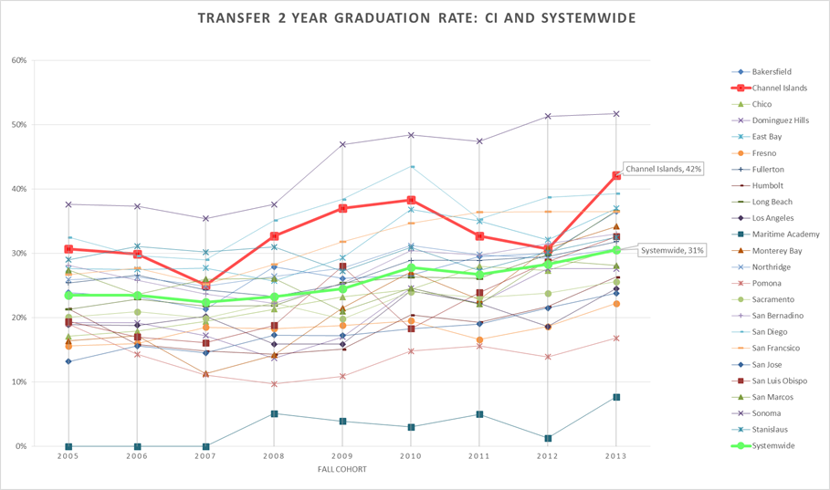
Two Year Transfer Graduation Rates Comparison across all Campuses and with the Systemwide Average

Slide 27
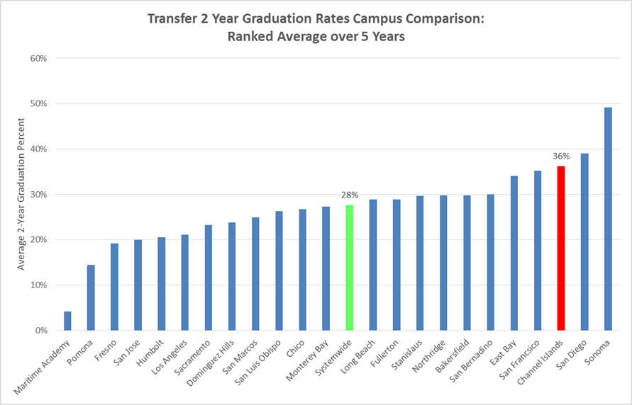
Two Year Ranked Average Transfer Graduation Rates across all Campuses & Systemwide

Slide 28
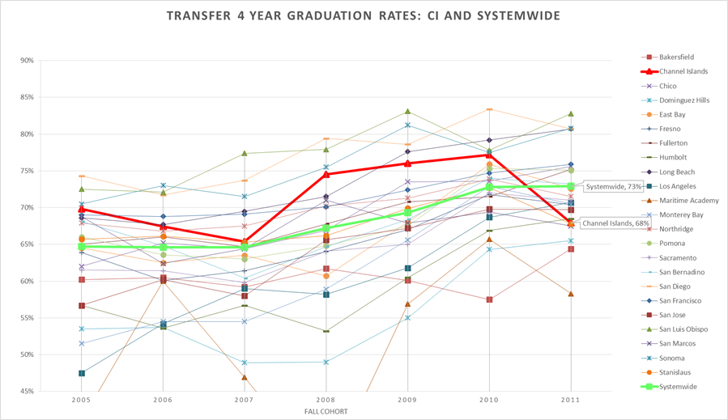
Four Year Transfer Graduation Rates Comparison across all Campuses and with the Systemwide Average

Slide 29
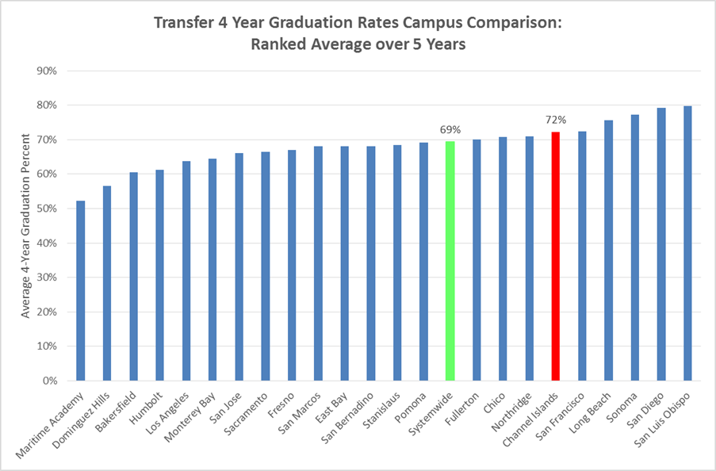
Four Year Ranked Average Transfer Graduation Rates across all Campuses & Systemwide

Slide 30
CI CCC Transfer 2 & 4 Year URM Graduation Gap

Slide 31
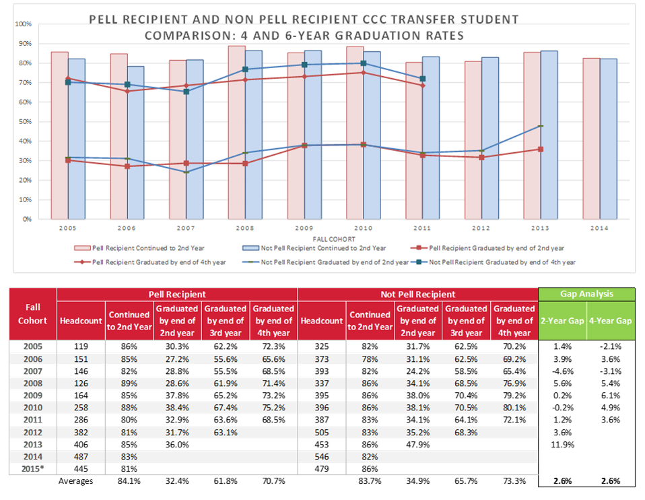
CI CCC Transfer 2 & 4 Year Pell Recipient Graduation Gap

Slide 32
CI CCC Transfer 2 & 4 Year First Generation Graduation Gap

Slide 33
Studies
Majors / Academic Unit Profiles
First year attrition?
Close Seniors
Seniors who do not graduate in 4th year
Degrees conferred w/Metrics

Slide 34
IRPE Updates
Update
  Data Warehouse
  Academic Unit Profiles
  New Definitions
  DGC
To Come this Year
  Dashboards
  Degrees Conferred w/metrics
  Student Success by majors
  BCSSE/NSSE Survey
  Commencement Survey

