Slide 1

University Advancement
Notes:
University Advancement represents the CI Foundation and seeks philanthropic contributions in support of the University’s mission and strategic plan from individuals, foundations, corporations and other organizations.
RSP facilitates the applications of all grant opportunities. However, any funder that requires a 501 c 3 is facilitated by the CI Foundation (and Advancement). Advancement does not deal with government grants or funding sources. This is what RSP specializes in for the campus.

Slide 2
Advancement’s Contribution to the CI Mission
Since 2002, Advancement has raised $46,585,415 for the Campus (and counting).
Some of the largest contributions brought to the campus by UA include:
$5 million to support the construction of the JSB Library
$8 million to support the naming of the School of Business and Economics and the construction of the Smith Decision Making Center.
$6 million to support the CI Nursing Program at Cottage Health Systems

Slide 3
Staffing Breakdown…
18 .5 FTE (all staff)
I Vice President
4 Fundraisers
4.5 Advancement Services Professionals
1 Budget Support Staff
4 Administrative Assistants
2 Event Staff
1 Alumni Engagement Staff
1 Advancement Special Projects Staff
Notes:
Average no. of Fundraising Staff in our peer group is 7.
Average no. of Alumni Engagement is 2.
Average no. of Admin Support is 3.5
Averagae no. of Budget Staff is 1
Average no. of Advancement Services is 4
Average no. of Event Staff is 2
Average no. of Advancement Special Projects is 1
Average no. of FTE is 30.5 for our peer group.

Slide 4
University Advancement’s Stateside Allocation
Perm Staffing - $1,407,183 (salaries only)
Perm Supplies / Operations - $153,632
Total Permanent Stateside Allocation: $1,560,816
Temporary Funds - $93,000
Total Stateside Allocation - $1,653,815
UA’s stateside allocation is 2.1% of the campus’ budget – the smallest divisional allocation for the campus.

Slide 5
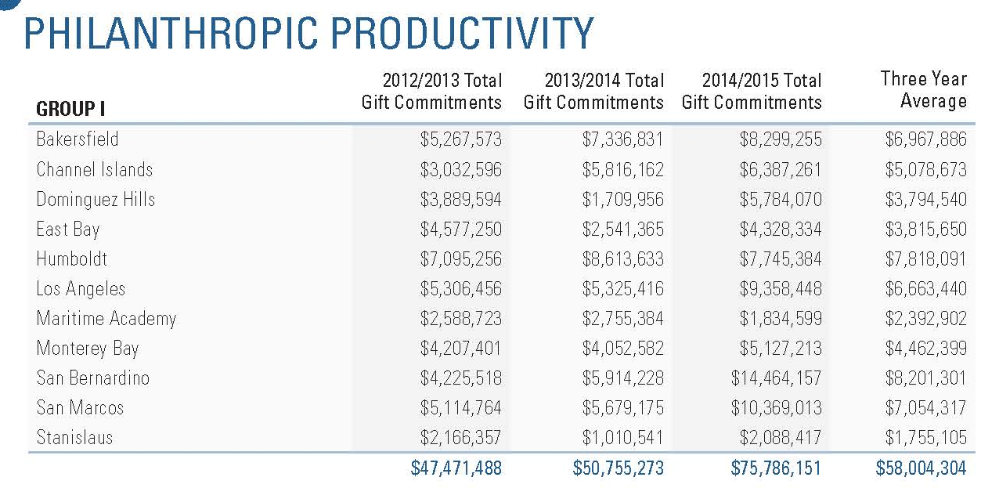
Within its peer group, CI out performed all but five of its 11 sister campuses in its three year average.

Slide 6
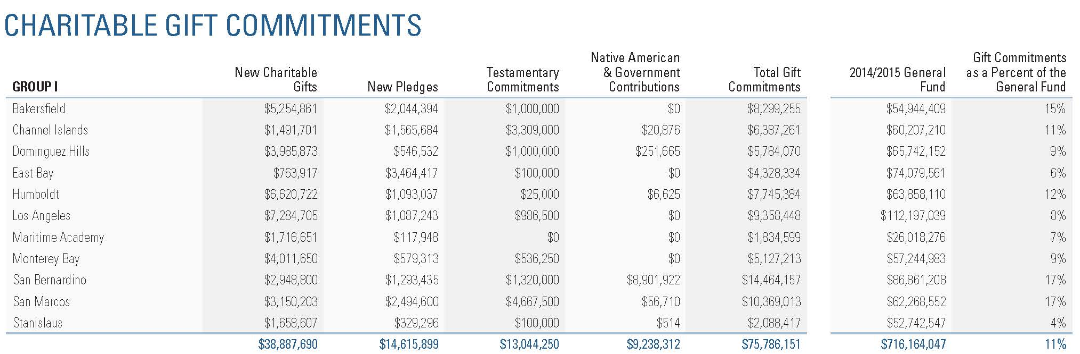
VSE Voluntary Support of Education
FY 14/15 Numbers Peer Group I

Slide 7
Revenue Allocations
FY 11/ 12 through FY 13/14

Slide 8
Fundraising Priorities
Fundraising Priorities are Determined by the University President.
The President seeks recommendations and input from the Provost and Vice Presidents and then makes the assignment to Advancement.
Notes:
However, Advancement is here to make connections and facilitate opportunities. We will work to take advantage of opportunities (when presented) even if they fall outside of our priority list.

Slide 9
Advancement’s Fundraising Goal
The Chancellor’s Office expects that we raise 10% of our campus state allocation.
However, we set our actual goal annually and based on what we “think” we can expect to secure in that fiscal year.
In the last three years, we have raised historic levels of funding for the campus.

Slide 10
Over $46.5 million in Gift Commitments Since FY 2002

Slide 11
Opportunities for Collaboration!
Tracking Alumni
Pass on promising contacts
Let us know about the exciting things you are doing!
Send us your ideas!

Slide 12

Questions?

Slide 13
Advancement’s Contribution to the CI Mission Con’t
Other significant contributions include:
Funding to launch and sustain the SAGE Research Forum
Resources to support creating courses such as Univ. 498, 398,298, and 198
Funding to support student internship opportunities
Student Scholarships and the creation of a student emergency fund

Slide 14
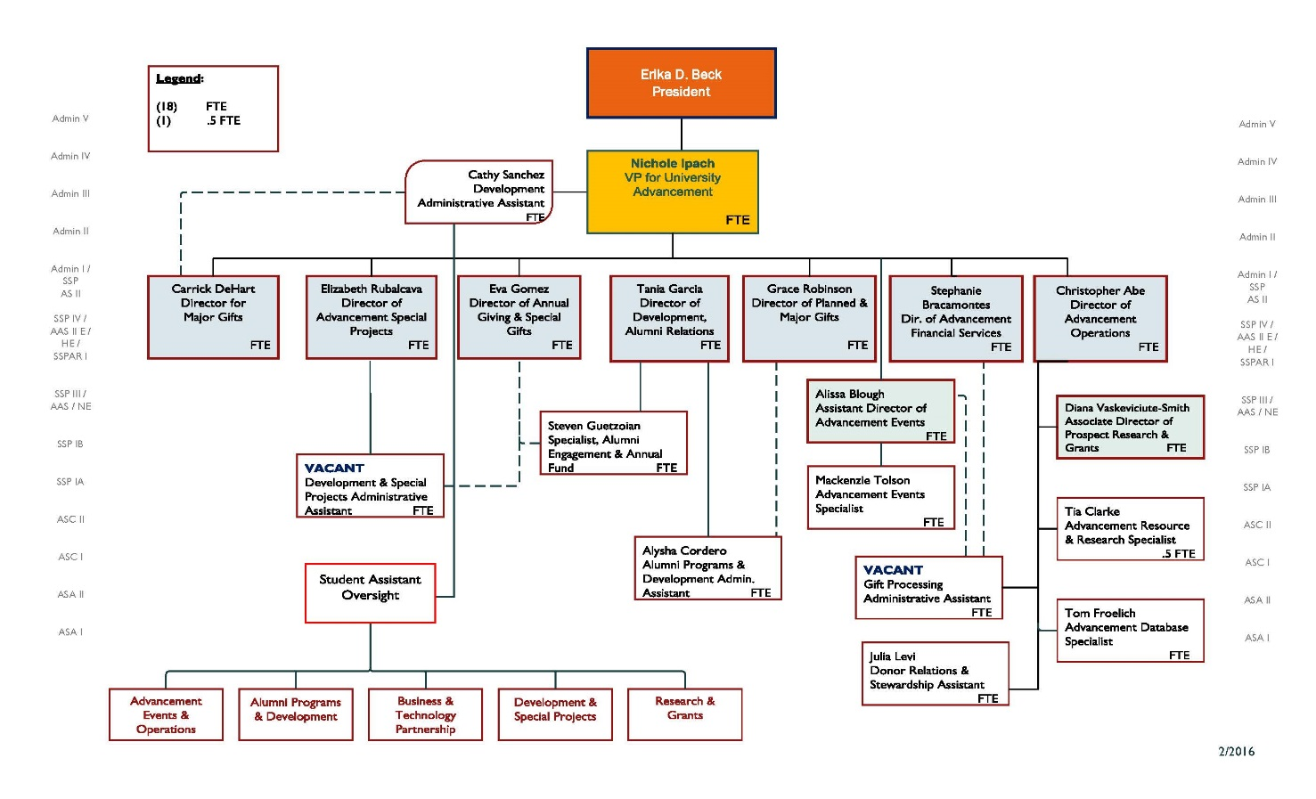
UA Org Chart 18.5 FTE

Slide 15
