Slide 1


All Faculty are invited to attend
A presentation on what is protected and what is not protected under the First Amendment
Presented by Marc Mootchnik, Esq.
University Counsel
November 16, 2017
8-9:15 AM
Location: Broome 2325
(Subject to change – advance notice will be provided)
“Free Speech & What It Means in the University Setting”

Slide 2
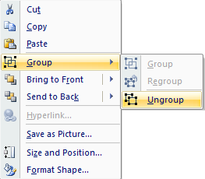
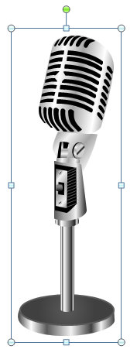
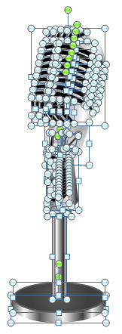
All images are 100% editable in Powerpoint
“Change color, size and orientation of any icon to your liking”
Ungrouping the object
1
Right click the object.
Choose Group and then Ungroup.
Click beside the object and drag the arrow over it.

Slide 3
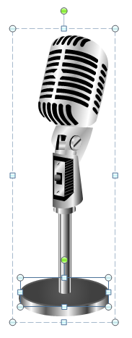
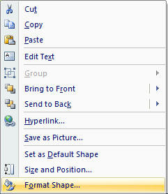
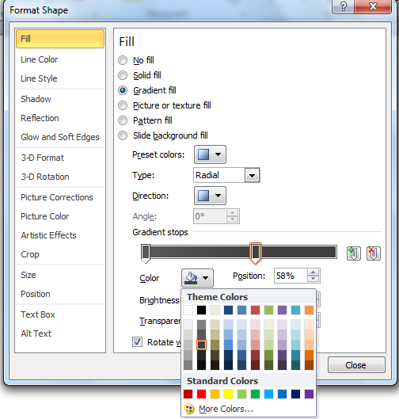
Edit Color
1
2
3
Right click the object
Choose Format Shape in the dialog box
Choose “Fill” in the Format Shape box then “Solid” or “Gradient” depending on the appearance of the object. Change colour as shown in the picture.

