Slide 1
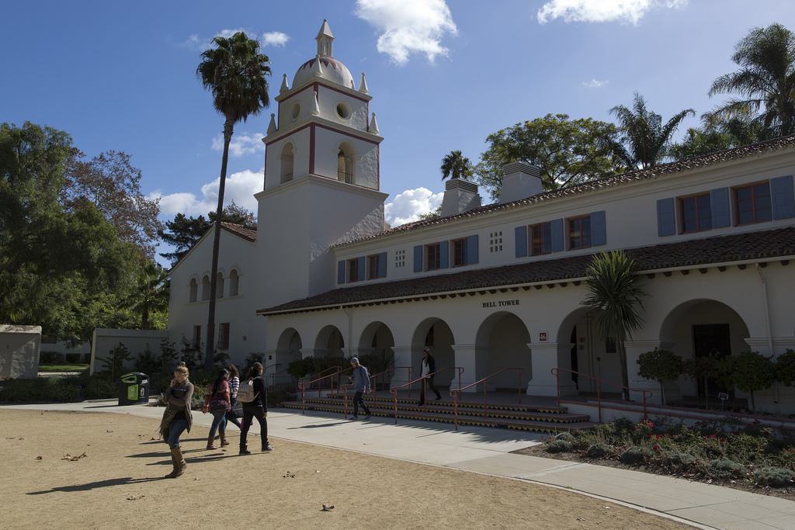

Academic Senate, 2/26/19
Intent to Raise Question

Slide 2
QUESTION
In the spirit of shared governance and respect, can the Provost create a taskforce of appropriate faculty or a forum of dialogue to address the question of Department oriented tenure-track searches versus the university’s long tradition of Interdisciplinary Recruitment that advances interdisciplinary student learning and faculty collaborations?
Frank Barajas
Academic Senate, 2.26.19
Intent to Raise Question

Slide 3
QUESTION
Three questions related to faculty hiring:
- Will candidates still meet with Administration (eg: President, Provost) during their on-campus interviews?
-Who will make the final decisions on hiring- the Dean? The Provost? The President?
-Re: this final decision on hires, what weight will Provost and President give to the DSC ‘s recommendations?
Debi Hoffmann
Academic Senate, 2.26.19
Intent to Raise Question

Slide 4
QUESTION
Question: In speaking to our staff colleagues in maintenance, it seems that many of them are not aware about our campus’s Active Shooter Training. Is the CSUCI Police Department’s Active Shooter Training available to maintenance and custodian staff? If so, are they able to attend during their work hours? Is the training available to maintenance and custodial employees including those who work evenings and late night shifts?
Julia Ornelas Higdon
Academic Senate, 2.26.19
Intent to Raise Question

Slide 5
ANSWER
Yes, our Surviving an Active Shooter Event training is available to maintenance and custodial staff, the same as it is available to all other employees and students. In addition to at least one offering per semester for students, we offer this course at least once per semester for employees, and we coordinate that training through the University’s Professional Development program. Employees’ participation in these courses is voluntary at this time.
Whether or not employees are able to participate in this training during their work hours must be determined by each employee’s supervisor, but I believe the intent of the Professional Development program is to make training opportunities available to employees during their normal working hours.
We have provided a version of this course specifically for Facilities Services staff in the past. If Facilities Services is interested in having us provide this training during the evening or overnight hours, we will be happy to do so
Chief Michael Morris
Academic Senate, 2.26.19
Intent to Raise Question

Slide 6
QUESTION
At CSU Monterey Bay, they have a smartphone app called "Otter Eats”. This App alerts students to events on campus that are ending where there is leftover food/snacks, allowing them the opportunity to come and enjoy the food so that it does not go to waste. Is it possible to develop such an App here at CSUCI, perhaps “Dolphin Eats” or “Echo Eats”?
—Billy Wagner
Academic Senate, 2.26.19
Intent to Raise Question

Slide 7
ANSWER
We are excited to share that we are actively working on this feature and …we will be utilizing the “GoCI” App to provide notifications to students. There will be a Basic Needs standalone icon embedded in the app that will have information about the Basic Needs Program that includes and is not limited to, hot meals, CalFresh sign-up assistance, Dolphin Pantry, emergency housing and the emergency grant. The App has a feature (like many other apps) that will allow students to “opt-in” to receive push notifications on their phones that will inform them of the location of available leftover food from catered events.
We recognize that not all of our students have access to a smart phone so we are working through some options (e.g. email, separate text notification from our office etc.) on how we may notify students who may not have access to that type of technology.
We’re currently working on the logistics of the rollout of the app and content and hope to have the app ready and launched by Fall 2019 (if not sooner).
Chelsee Benté, M.A.
Basic Needs, CARE & Student Conduct Administrator
Academic Senate, 2.26.19
Intent to Raise Question

Slide 8
NEW QUESTION
The CI Boating Center is an incredible facility. It has potential to further our connection to Oxnard, and I encourage my colleagues to continue to think of innovative ways to utilize the space. Although we are able to reserve the classroom space at no cost, we are required to pay a $42 locksmith fee to unlock and lock the door. I’m concerned this fee might create an obstacle for certain groups or anyone who might be interested in utilizing the space. Is there a way to work with facilities or CI boating center staff to have that locksmith fee waived? Thank you for the consideration.
Luis Sanchez
Academic Senate, 2.26.19
Intent to Raise Question

Slide 9
NEW QUESTION
In the last five years CAPS has faced several challenges that included: increased demand for services, reduced staffing, the training program being placed on hold, changes in leadership, and several campus and statewide related tragedies. Given these challenges, are counselor tenure positions going to be re-considered in order to provide greater stability and retention for faculty and for students?
Brittnee Veldman
Academic Senate, 2.26.19
Intent to Raise Question

Slide 10
NEW QUESTION
I currently have students who have DACA and undocumented status looking to apply for graduate school. In the past, due to the Ally training, students felt relatively safe divulging their status at either the Career Center the Graduate Studies Center (GSC).
a. With Martha Zavala from the Multicultural Dream Center and Aracely Flores from the GSC no longer on campus, what is CI doing to ensure our Dreamer students can plan for graduate school with a strong measure of ensured safety?
b. Can The Academic Senate please invite Martha’s replacement to speak about their role on campus?
c. Since all programs send students to graduate school, is there a plan to institutionalize the GSC so that Education does not have to bear the burden of the cost?
Brittnee Veldman
Academic Senate, 2.26.19
Intent to Raise Question

Slide 11
NEW QUESTIONS???
Academic Senate, 2.26.19
Intent to Raise Question

