Slide 1
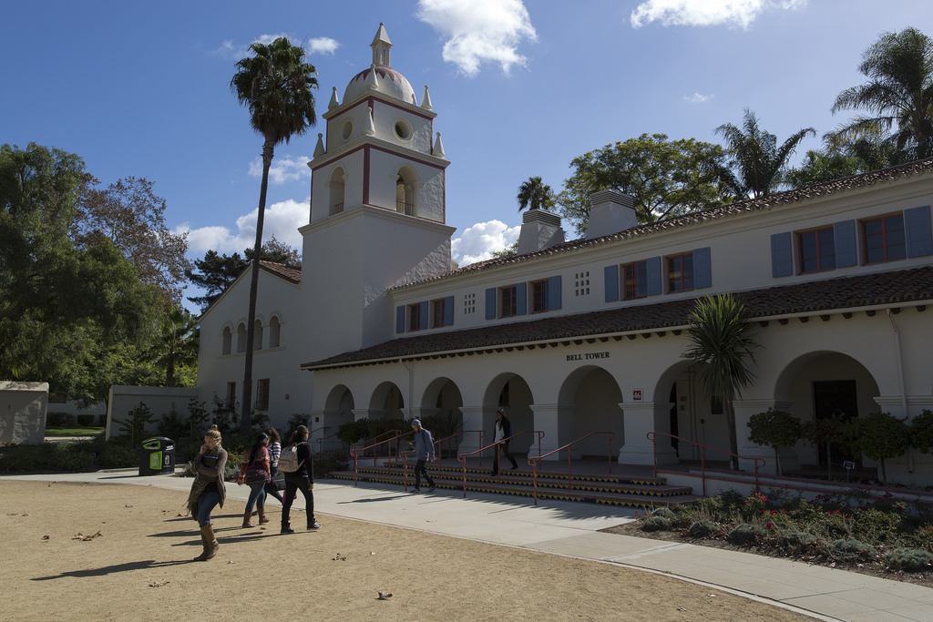

Academic Senate, 10.23.18 Intent to Raise Question

Slide 2
Apology
Last Academic Senate meeting, the Vice Chair misrepresented an ItRQ question raised by a faculty member. For that error, he apologizes both to Theresa as well as the body. He also misspelled her name.
If you identify or encounter errors, please do not hesitate to let the Vice Chair know. The goal is to properly register a question and to obtain an appropriate response. Mistakes may occur. Mistakes will be fixed.
Matt Cook
Academic Senate, 10.23.18 Intent to Raise Question

Slide 3
QUESTION
Could each committee report at the end of each semester or year?
Points to address could include:
- members
- meeting dates
- accomplishments
- awards of funds, naming project, awardees, and amounts
- and any other comments they feel pertinent to share?
Also, is there the possibility to allow committees to present once a year, one or two per meeting, instead at every meeting, to present and address committees objective's and progress for semester?
Theresa Avila
Academic Senate, 10.23.18 Intent to Raise Question

Slide 4
ANSWER
These are excellent questions and considerations. Right now, there is currently no requirement that committees report back to faculty in any sort of regular or official manner. I will ask the by-laws working committee to consider this or these issues and make the appropriate changes.
Note that standing committees do have great leeway to conduct their own communication efforts, including brown bags, surveys, or other mechanisms. Additionally, they have a scheduled time on the Academic Senate agenda to report.
Dr. Virgil Adams
Academic Senate, 10.23.18 Intent to Raise Question

Slide 5
QUESTION
Previous drafts of CSUCI’s strategic plan included a childcare center/early childhood education lab to serve the children of students, faculty, and staff, and to help train our education majors.
What is the current status of the proposal to develop a childcare center on our campus?
Julia Ornelas-Higdon
Academic Senate, 10.23.18 Intent to Raise Question

Slide 6
ANSWER
As you may know, there has been a long history on this subject. Faculty have engaged students and prepared studies that I believe have been presented to prior Provosts in pursuing an academic program that would include an ECE lab, though I, personally have not seen the studies. I can say that in the past, our facilities staff have been consulted about the cost of capital facilities for an ECE/child care facility. These facilities are typically funded as a self-support project with cost of the operations and debt for the facility covered by fees paid by those whose children attend.
So, from my understanding, although there has been some discussion about the capital facilities, that is secondary. The precursor is the academic program need that would drive the discussion and planning.
Ysabel Trinidad
Academic Senate, 10.23.18 Intent to Raise Question

Slide 7
ANSWER
I have not been part of any specific discussions about a potential child care center/early childhood lab. When I initially started, I had inquired about any data related to child care needs for our students (as there was a grant opportunity I was interested in potentially pursuing). However, I have not had any substantial follow-up since that time
Richard Yao
Academic Senate, 10.23.18 Intent to Raise Question

Slide 8
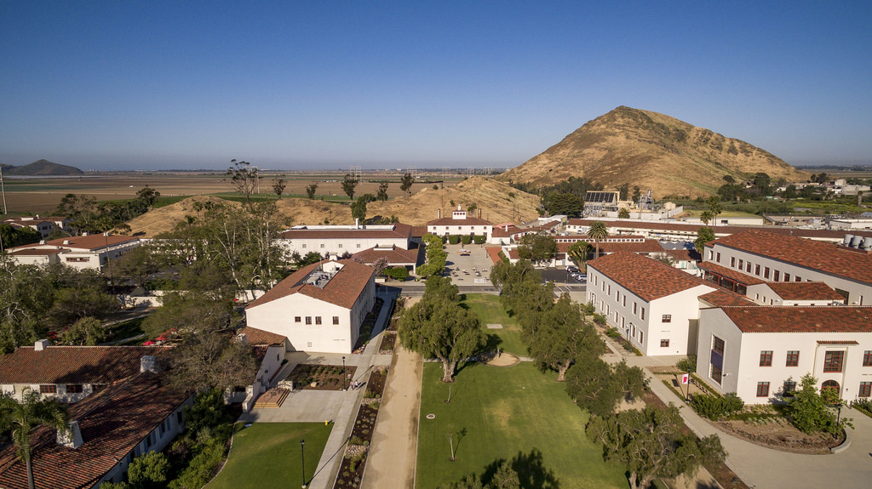
itrq finis
Academic Senate, 10.23.18 Intent to Raise Question

