Slide 1
Policy # SP 13-06 on Academic Dishonesty

Slide 2
Goals for updating the policy on academic dishonesty (previously SP 02-01, now SP 13-06)
To bring the policy into compliance with CSU Executive Orders 1037 and 1098 and clarify reporting and investigating procedures
Reporting
Grade forgiveness
Guidance for faculty which will hopefully result in standardization and an increase in reporting without forcing any specific guidelines on faculty
Outlines a process for students to appeal academic dishonesty rulings

Slide 3
Major Changes
Previous Policy
Current Policy
Cases of academic dishonesty reported to Provost’s office
Grades resulting from academic dishonesty are not supposed to be subject to grade forgiveness, but this was not being reported to the Registrar’s office
A lack of standardization for defining and dealing with academic dishonesty may be leading to confusion and underreporting by faculty
Policy states that decisions can be appealed, but no process for this existed
Cases of academic dishonesty reported to the Dean of Students Office
New procedure will ensure Dean of Students office submits grade outcome to Registrar’s office to prohibit students from retaking courses for grade forgiveness
Definitions for academic dishonesty and recommendations in an appendix can help guide faculty in making decisions about academic dishonesty in their classes
Policy now outlines a clear appeals process with the creation of an Academic Appeals Committee to review these

Slide 4
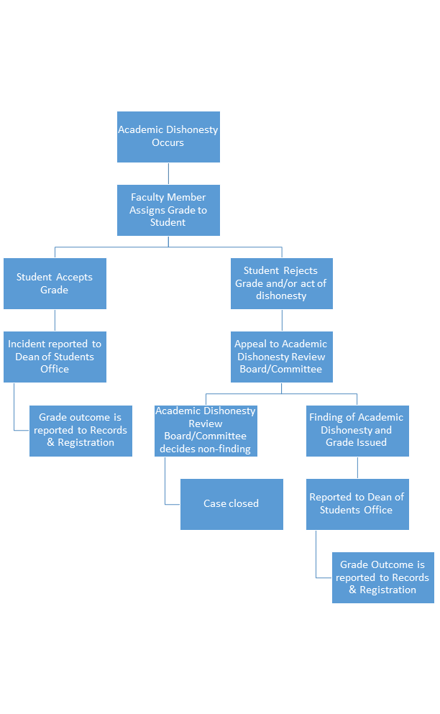

Slide 5
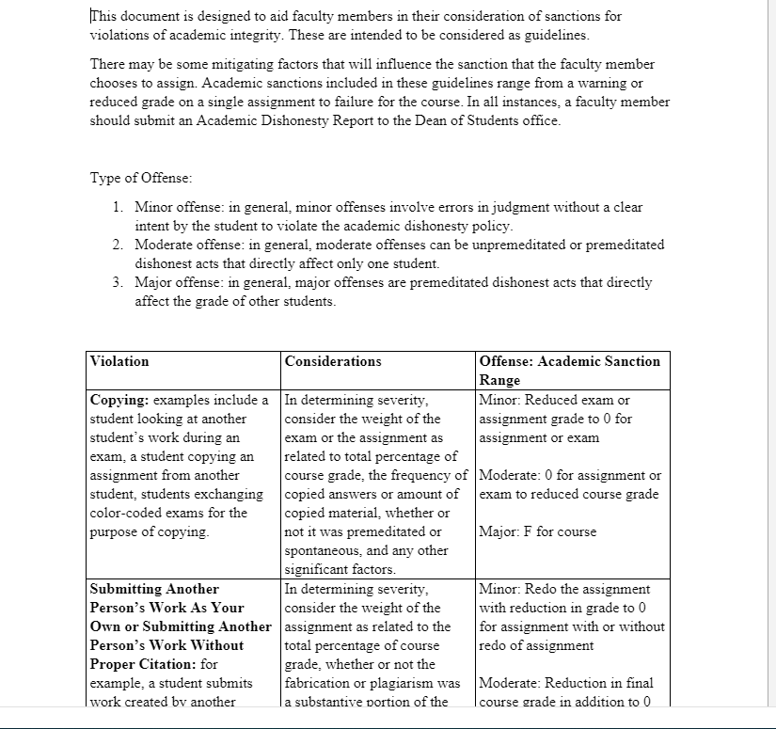
Appendix: Academic Sanction Guidance

