Slide 1
Highlights of Proposed changes SP 12-10
Policy on Lecturer Evaluation
Faculty Affairs Committee

Slide 2
Overview
Existing policy
Proposal
CBA

Slide 3
Overview-Process
September-October: identified issues; solicited input
November-February: Revised policy in collaboration w/ Faculty Affairs
March: Brown bag
April: Revised policy in response to feedback

Slide 4
Sections
SP 12-10 (11 sections)
SP 18-XX (7 sections)
Philosophy
Purpose
Definitions
General
Full-time lecturers
Part-time lecturers
Lecturers holding or eligible for a 3-year contract
Lecturers hired for one semester or less
Portfolio
Evaluations
Criteria for Evaluation
Philosophy
Purpose
Definitions
General
Evaluation Process
Portfolio
Criteria for Evaluation

Slide 5
Major changes
General
Evaluation Process
Portfolio

Slide 6
Section D: General

Slide 7
Role of probationary faculty: clarified
SP 12-10: “Only tenured faculty can serve on peer review committees. Probationary faculty may provide peer input, but may not engage in deliberations or make recommendations.”
“provide input”?

Slide 8
Observations of lecturers
Proposal: Tenured faculty whenever possible
“Program chairs are advised to assign tenured faculty to perform the required observations of lecturers as part of the lecturer evaluation process.
If there are insufficient tenured faculty in the program to perform said observations, the chair may invite tenured faculty from other programs, or tenure-track faculty from within the program, to do so.

Slide 9
Observations
Proposal: Training for observers: make more meaningful
“Program chairs, in coordination with the Office of Faculty Affairs, the Director of Faculty Development, and the Faculty Development Advisory Committee, shall ensure that faculty assigned to perform observations of lecturers as part of the lecturer evaluation process are adequately trained to do so.”

Slide 10
Section E: Problem
SP 12-10
SP 18-XX
Part-time lecturers 1-yr. contract
One-stage review
What happens if “unsatisfactory”?
  “In the event of an ‘unsatisfactory’ rating…the dean shall subsequently write a separate evaluation of the lecturer.”
  Protection
  Confirmation
  Oversight

Slide 11
Section E: Rating system: lack of nuance
SP 12-10
SP 18-XX
“Satisfactory”
“Unsatisfactory”
“Satisfactory-With Distinction”
“Satisfactory”
“Satisfactory-With Concerns”
“Unsatisfactory”
Encourage & recognize excellence
Raise flags when necessary

Slide 12
Section F: Portfolio
SP 12-10
SP 18-XX
Only required of full-time lecturers
Required for all lecturers
“Given the importance of promoting reflective practices and a culture of continuous improvement among all faculty, a portfolio shall be submitted by all lecturers being evaluated, regardless of full- or part-time status”

Slide 13
Rationale
Wholistic
Opportunity to showcase accomplishments
More complete vision
Feedback received:
“making the Portfolio mandatory for all lecturers…would ensure that evaluations of teaching performance are based not strictly on SRT results and peer evaluations of teaching, but also on other evidence of teaching effectiveness..”

Slide 14
Portfolio contents
SP 12-10
SP 18-XX
Required: CV, syllabi, observation, student evaluations
Optional:
Course materials
Self-assessment (500-word max)
Required: CV, syllabi, observation, student evaluations
Required: Selected course materials
Required: Self-reflection (750-word max) highlighting accomplishments, strengths, areas for improvement, etc.

Slide 15
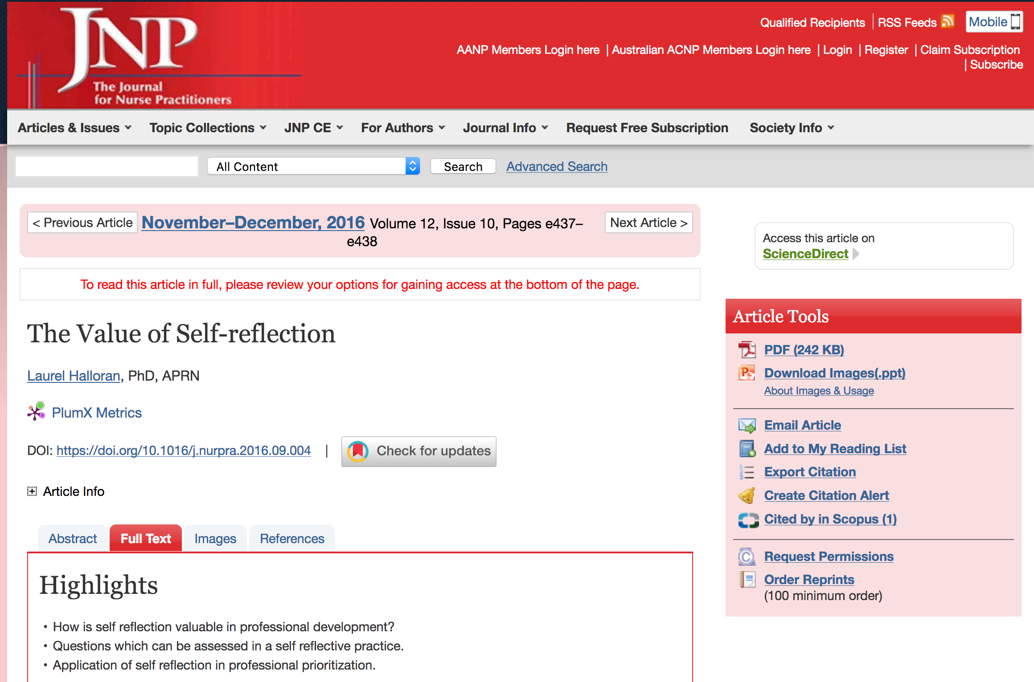

Slide 16

Laurel Halloran, PhD, APRN
Lecturer at Boston University Medical School & Tufts Center for Drug Development. Previously taught at George Washington U and Harvard.

Slide 17
Laurel Halloran, PhD, APRN
“We require nurse practitioner students to prepare portfolios, including reflections evaluating their skill sets…It makes me think that this exercise should be required for all professionals to do once a year.”
“Self-reflection should not be about beating yourself up. It should be a productive evaluation of what is working and not working well…based on core values and priorities. It should allow for identification of excellence and concrete plans for improvement. Self-reflection is an empowering ritual by which we can gain clarity about the things we have done and are facing…a conscious, dynamic process of analyzing and learning from experience……”

Slide 18


Slide 19
Do you want to be the sage on the stage or the guide on the side?
It’s a question that Pamela Mason poses to her students each spring, right before she drops the bomb that causes the class to squirm; namely that part of their final grade will be based on based on a self-reflection they’ll write after watching a video of themselves teaching.
As soon as the lesson is explained, “all of the air gets sucked out of the room,” says Mason. But once students understand that they are not being judged on their video performance — but rather on how they reflect on their video — the dynamic changes.

Slide 20
“We have always included these video reflections as part of our pedagogy,” says Mason, who serves as faculty director.
“What it gives us is an opportunity for the students to authentically reflect on what they are teaching, how they are teaching it, and how they are responding to students’ engagement or lack thereof.”

Slide 21


Slide 22
When people find out I’m an executive coach, they often ask who my toughest clients are. Inexperienced leaders? Senior leaders who think they know everything? Leaders who bully and belittle others? Leaders who shirk responsibility?
The answer is none of the above. The hardest leaders to coach are those who won’t reflect — particularly leaders who won’t reflect on themselves.

Slide 23
“At its simplest, reflection is about careful thought…Reflection gives the brain an opportunity to pause amidst the chaos, untangle and sort through observations and experiences, consider multiple possible interpretations, and create meaning. This meaning becomes learning, which can then inform future mindsets and actions.”

Slide 26
Section G: Criteria for Evaluation
SP 12-10
SP 18-XX
Evidence of teaching effectiveness may include (not listed in order of importance):
  Currency in field and subject matter competence as measured by advanced degrees…
Evidence of teaching effectiveness may include but is not limited to the following (not listed in order of importance):
  Currency in field and continuing professional development…

Slide 27
Section G: Criteria for Evaluation
SP 12-10
SP 18-XX
Evidence of teaching effectiveness may include (not listed in order of importance):
  Grading practices
Evidence of teaching effectiveness may include but is not limited to the following (not listed in order of importance):
  Fair, consistent and rigorous grading practices (e.g., use of rubrics)

Slide 29
Other feedback from lecturers incorporated
Stage one: The first stage of review will be by a committee of tenured faculty appointed according to the program’s by-laws.
-- Is this a new statement? Do all programs have by-laws? My concern is can we accommodate - not sure how this has been done, if done at all, in the past.
(we took care of this by eliminating references to by-laws)

Slide 30
Feedback from Lecturers
Section E -1: add a location or person that the lecturer is to submit the portfolio to. List the actual materials to submit & to who (if something more than the portfolio is required by the lecturer).
See E #8:
“The portfolio shall be submitted by the lecturer to their program chair(s) or to the Faculty Affairs Office and shall be incorporated by reference into the PAF."

Slide 31
Feedback from Lecturers
Specify a Timeline & an official requester for Portfolios: Maybe it would be good to designate the Chair or her/his designee a date & time to contact lecturers that they will need to submit a portfolio. Perhaps state a time frame like 60 days from such and such a date your portfolio is due, for example. Policy gets forgotten when there is no designation of roles/duties, so designate a requester & the obligation of the lecturer. (the materials of the portfolio are clear in this policy, but the lecturer obligations, where/how to turn things in, dates, and minimum time frame for a specific date are very unclear).
Response: The calendar and details are listed on Faculty Affairs website: https://www.csuci.edu/academics/faculty/facultyaffairs/documents/evaluation/lecturerevaluationschedule-2018-19.pdf

Slide 32
Feedback from lecturers
Is it necessary to include six nearly identical syllabi in a Portfolio for a three-year contract renewal? Or would one example suffice? I would be grateful for some clarification of this language.
See F#2. We clarified this point:
“Syllabi for all courses taught during the evaluation cycle (only one syllabus for multiple sections of the same course)”

Slide 33
Other feedback from lecturers incorporated
Language correction to reflect not all lecturers are teachers
Example:
“observation” rather than “teaching observation”

Slide 34
Other feedback from lecturers incorporated
Section K, discourages creative activities and service by lecturers….Some lecturers carry a large (uncompensated) burden of research and service. If CI wishes to encourage these activities by lecturers, then this paragraph should be changed to reflect that.
See section G, #2. Slight language change.

Slide 35
SP 12-10:
2. In most cases, lecturers hired to teach do not have scholarship, creative activities or service as part of their job duties, and scholarship, creative activities or service should only be considered if they are directly tied to the lecturer’s currency in the field and subject matter competence with respect to the actual courses being taught.

Slide 36
SP 18-XX:
2. In most cases, lecturers’ responsibilities are limited to their role as instructors, with no expectation or requirement of scholarship, creative activities or service. However, evaluations of lecturers may consider scholarship, creative activities or service when these activities are directly relevant to the lecturer’s currency in the field or subject matter competence with respect to the duties of the lecturer’s appointment (e.g., the courses being taught).

